Slide 1

Transport Phenomena
M.Sc
Chemical Engineering Department
Basrah University
Prof. Dr. Ala’a Abdulrazaq

Slide 2
Contents:
Boundary Layer
Momentum equation
Steady-state momentum balance over the element
The streamline portion of the boundary layer laminar and turbulent boundary layer
Boundary layer theory applied to pipe flow boundary layer for heat transfer
Heat transfer for streamline flow over a plane surface — constant surface heat flux
Heat transfer for streamline flow over a plane surface — constant surface temperature boundary layer for mass transfer boundary layer for heat transfer
Reynolds analogy
Simple form of analogy between momentum, heat and mass transfer
Application of the boundary-layer theory drying processes evaporation processes humidification and de-humidification processes

Slide 3
References
1-chemical engineering, V. 1 By Coulson & Richardson's
2- Transport Processes and Separation Process By: Gean Koplis
3-Transport phenomena and unit operations By:Richard G. Griskey
4- Transport phenomena By:Robert S. Brodkey and Harry C. Hershey

Slide 4
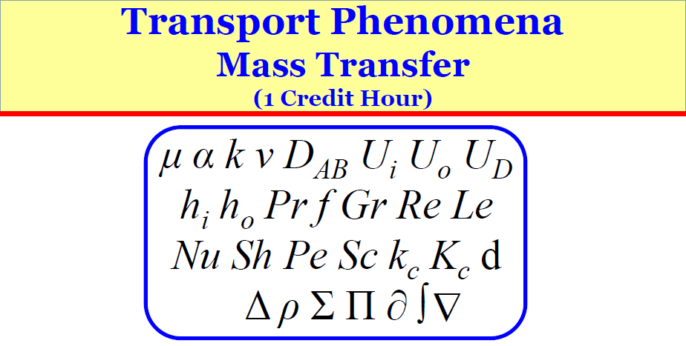

Slide 5
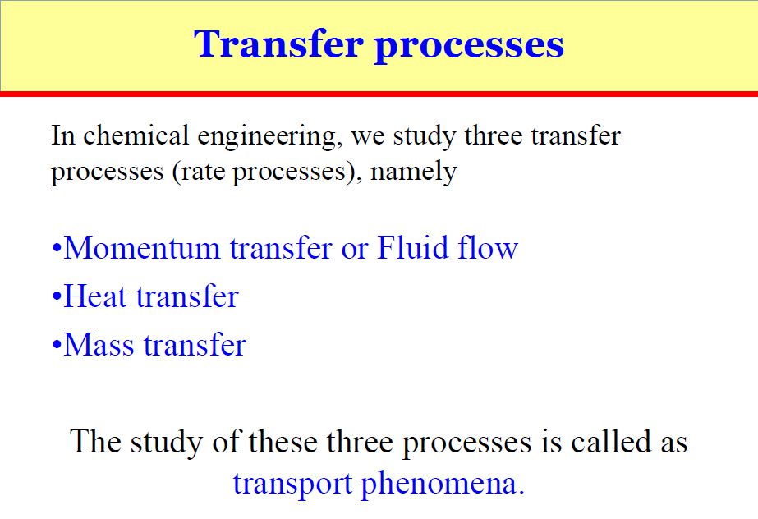

Slide 6
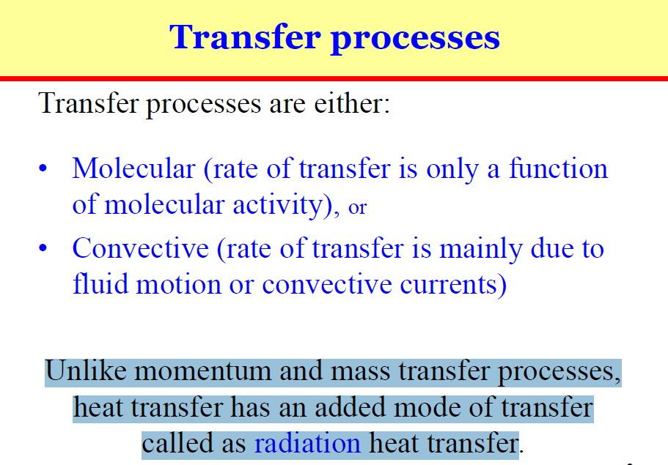

Slide 7
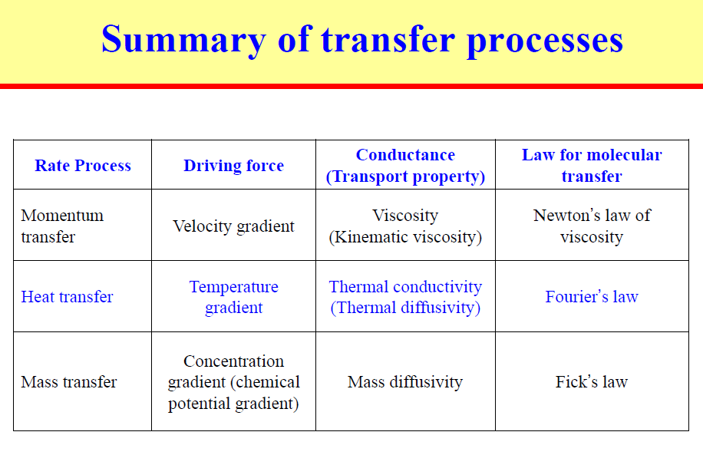

Slide 8
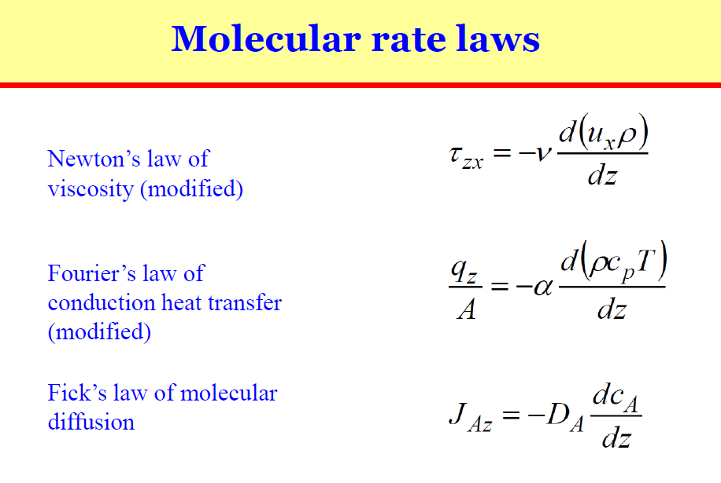

Slide 9
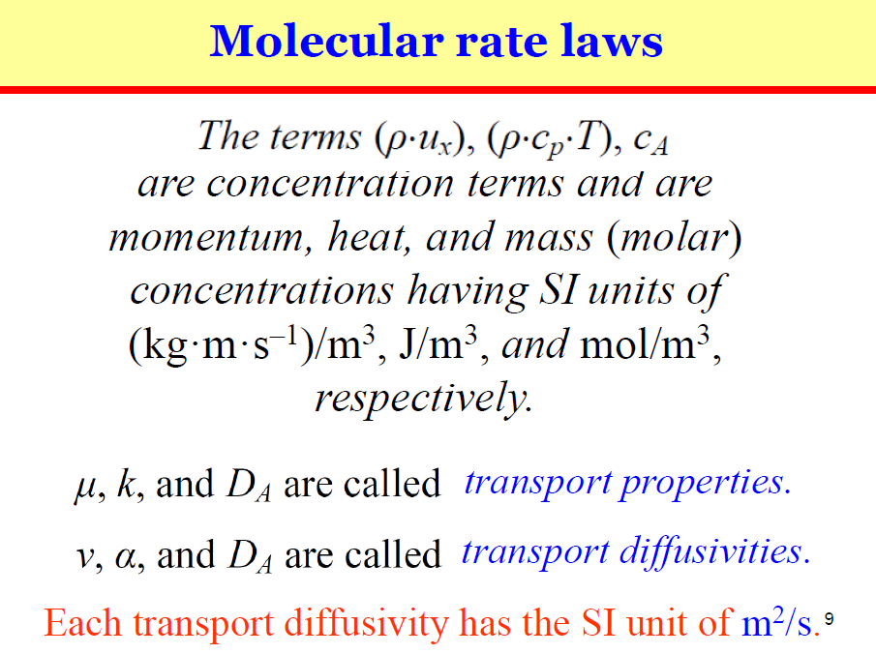

Slide 10
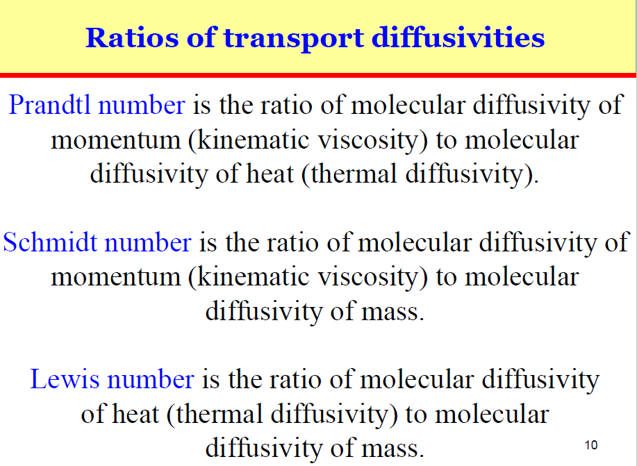

Slide 11
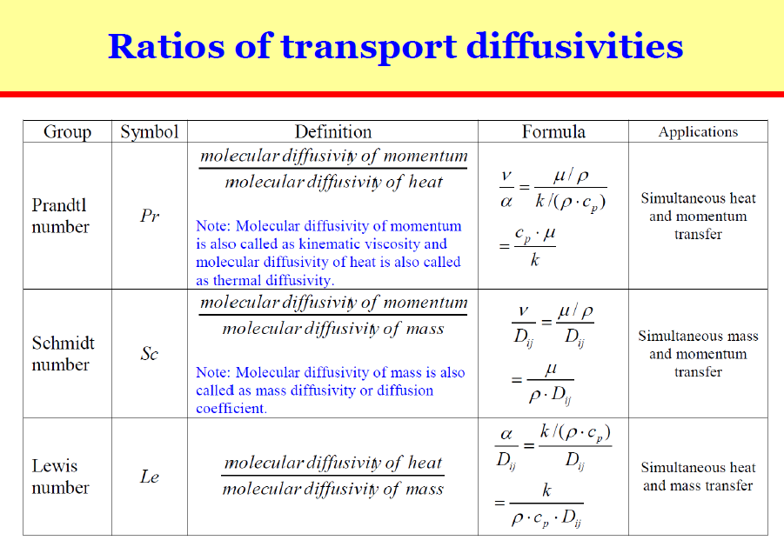

Slide 12
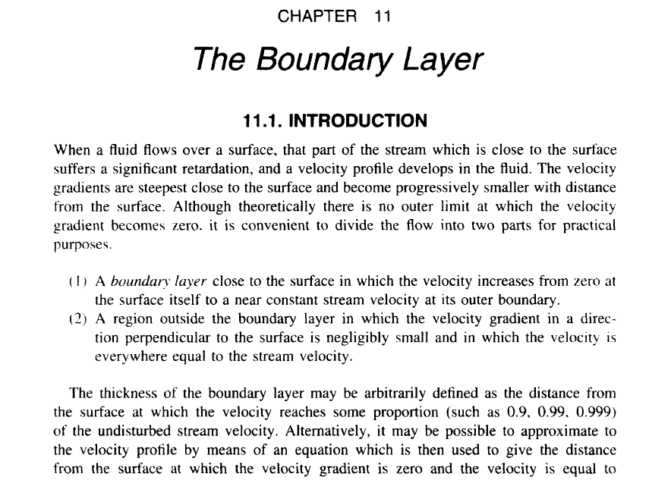

Slide 13
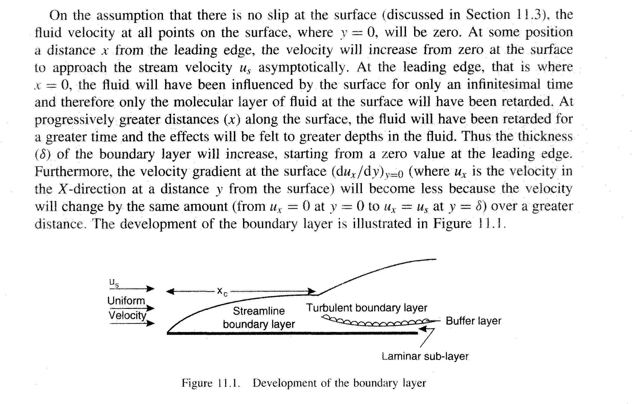

Slide 14
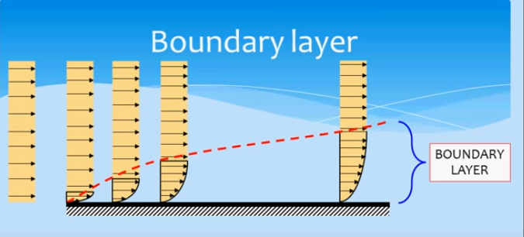
الطبقة المتاخمة: هي المنطقة التي يظهر فيها تأثير الاحتكاك

Slide 15
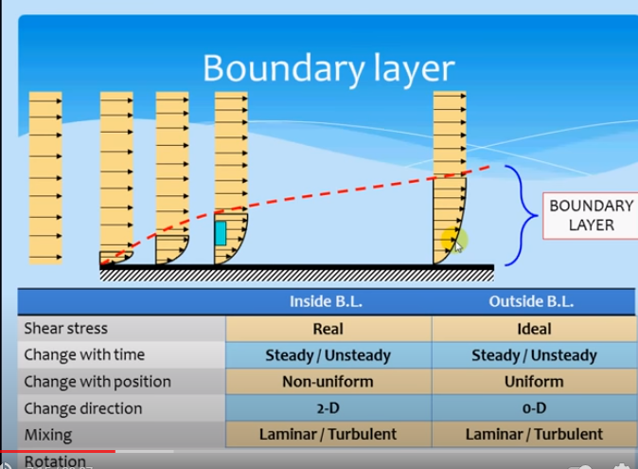

Slide 16
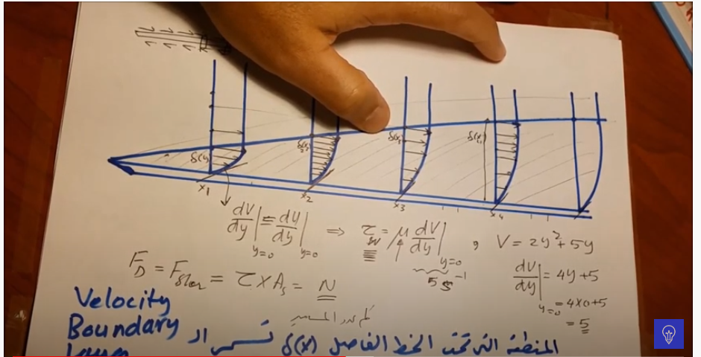
F_{D} Drag force v or u= velocity ζ = shear stress
كلما ازداد معامل الاحتكاك كلما زاد هبوط الضغط cf=shear stress/0.5ρ u²

Slide 17
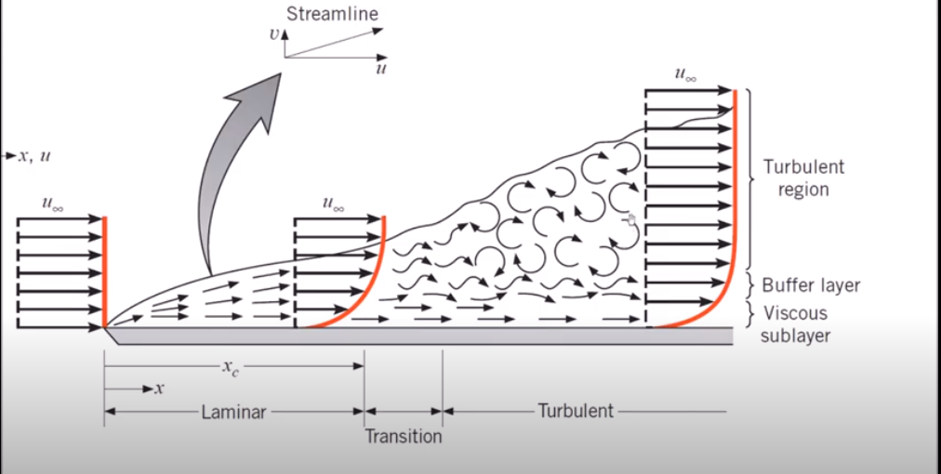
الانتقال في منطقة الجريان الانسيابي يحدث بسبب molecular diffusion
الانتقال في منطقة الجريان الاضطرابي يحدث بسبب bulk motion mechanism او turbulent mixing
منطقة sub layer يكون فيها الجريان انسيابي والانتقال بالانتشار
Critical Re. Number=100,000

Slide 18
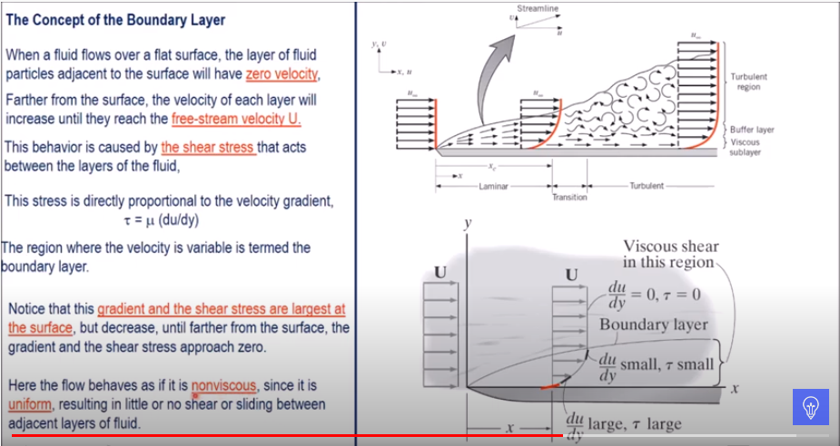

Slide 19
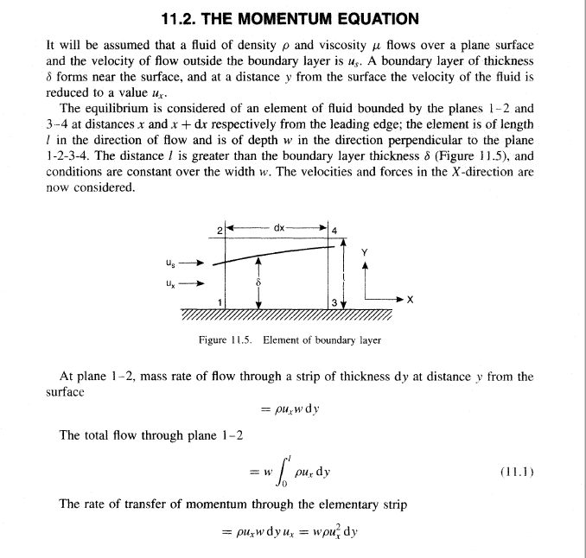

Slide 20
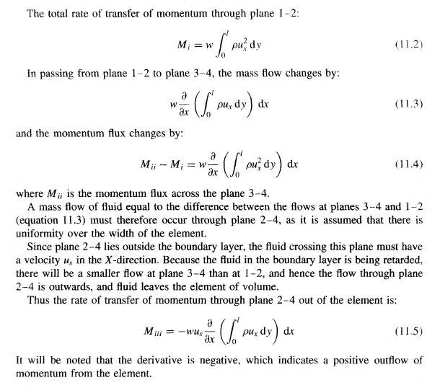

Slide 21
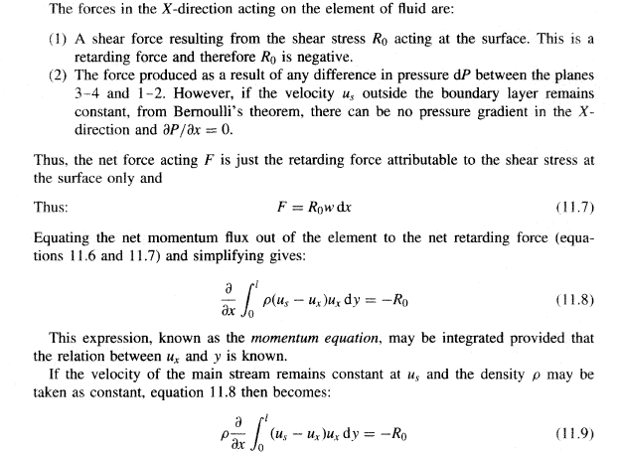

Slide 22
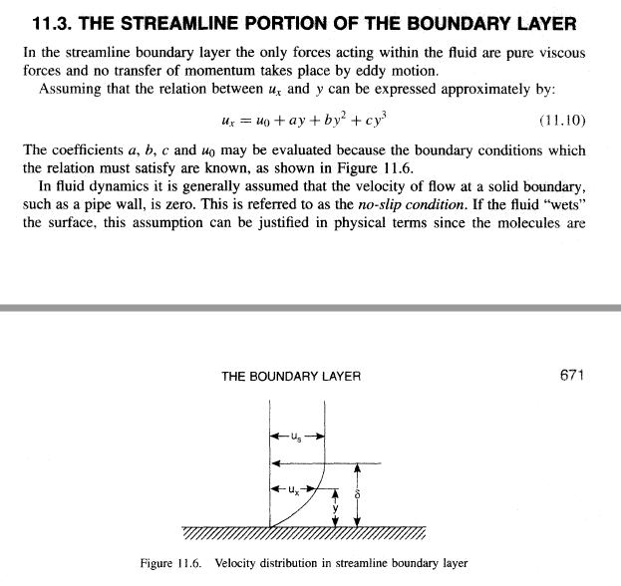

Slide 23
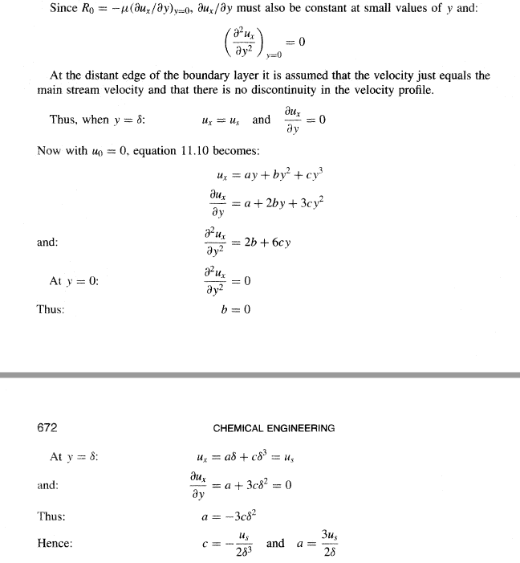

Slide 24
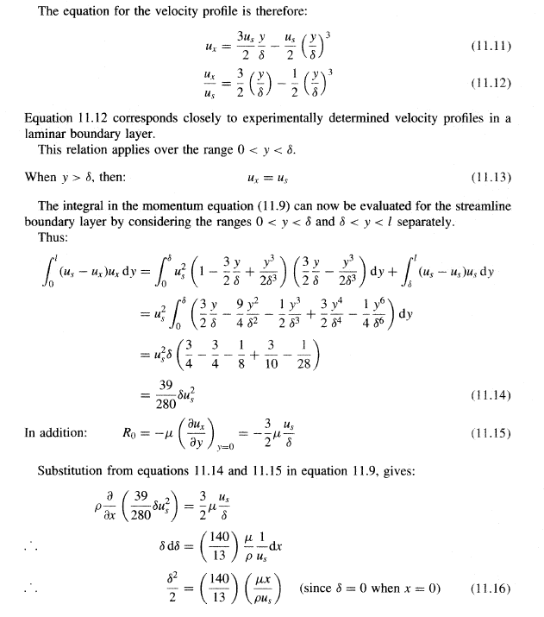

Slide 25
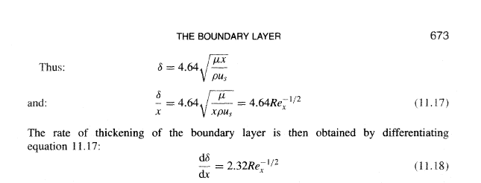

Slide 26
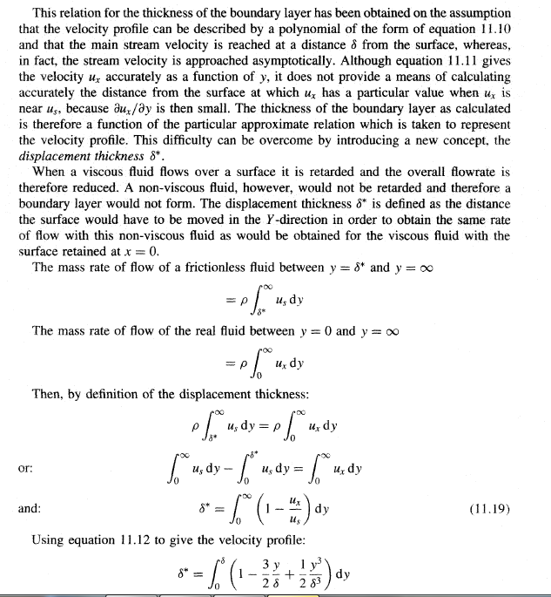

Slide 27
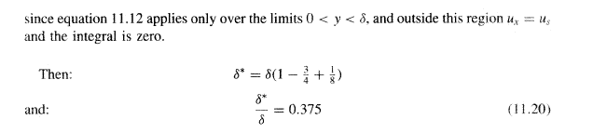

Slide 28
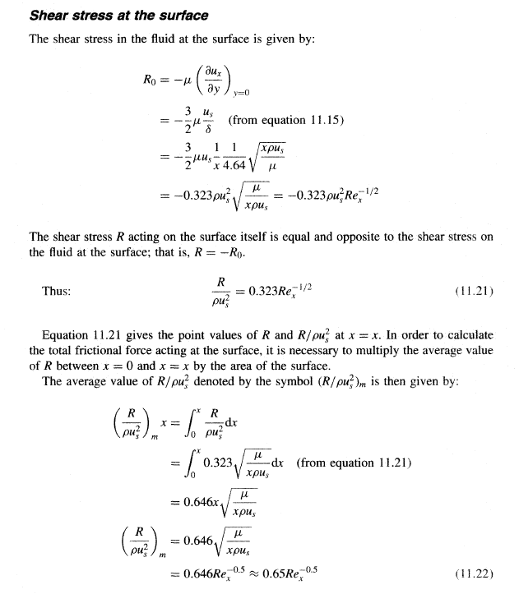

Slide 29
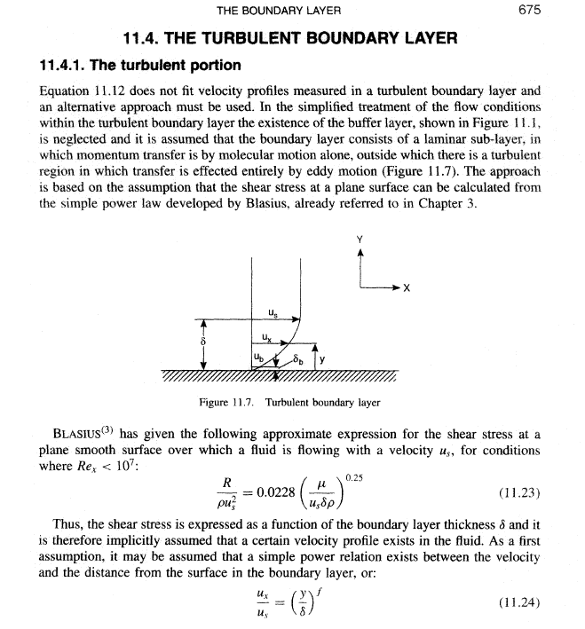

Slide 30
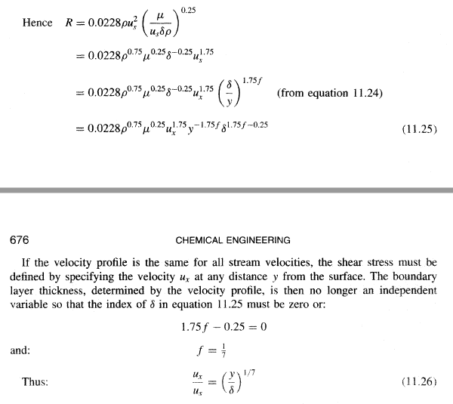

Slide 31
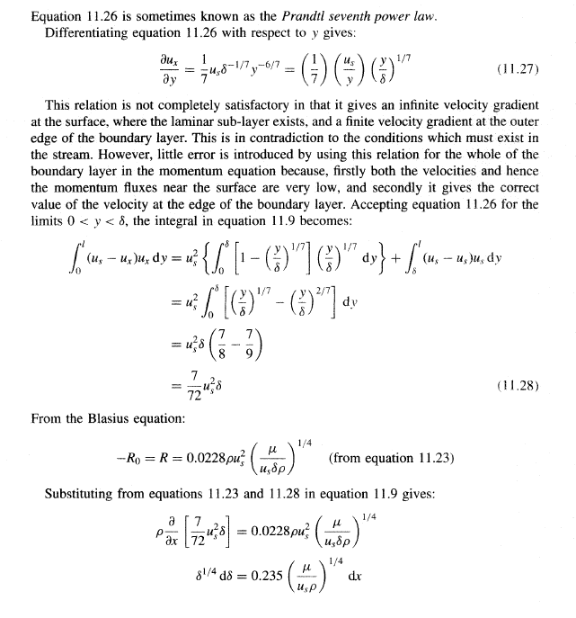

Slide 32
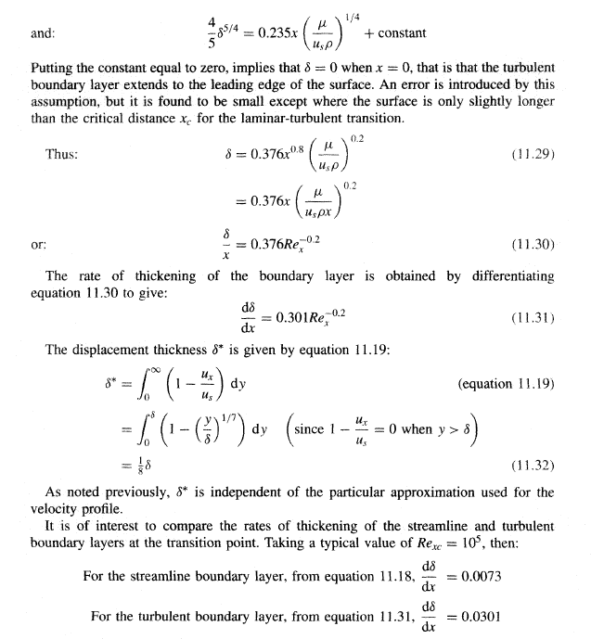

Slide 33
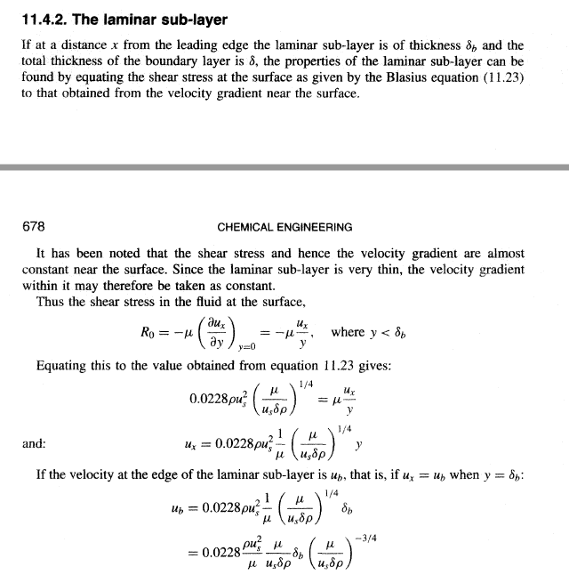

Slide 34
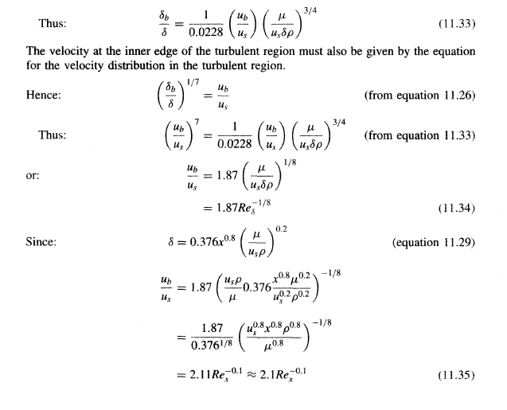

Slide 35
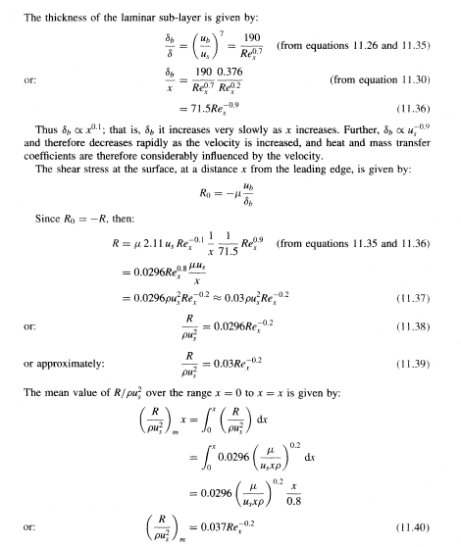

Slide 36
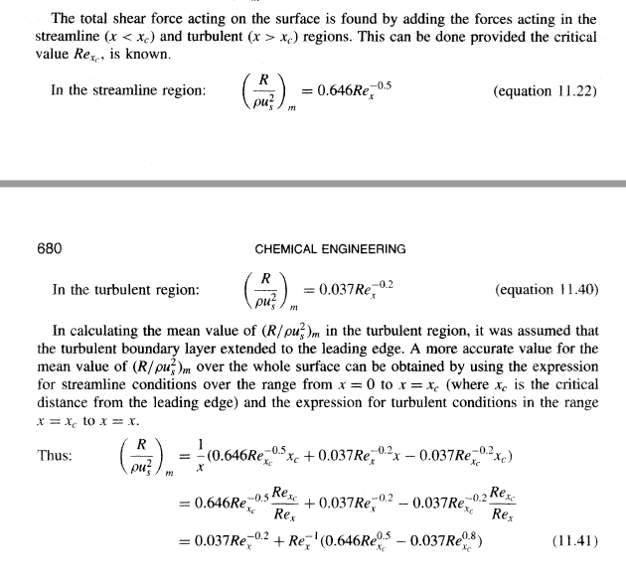

Slide 37
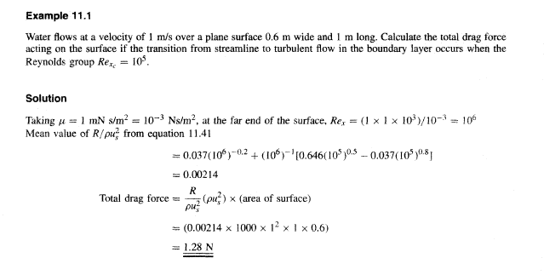

Slide 38
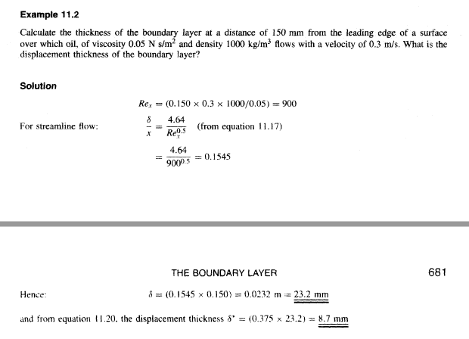

Slide 39
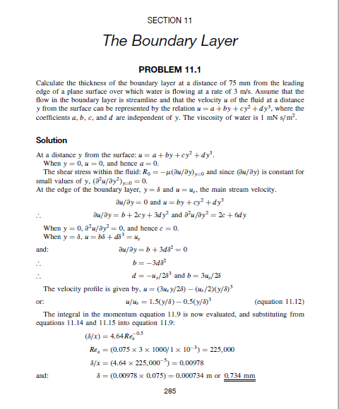

Slide 40
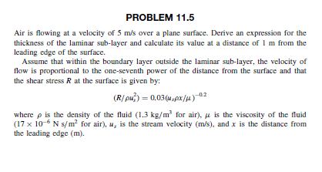

Slide 41
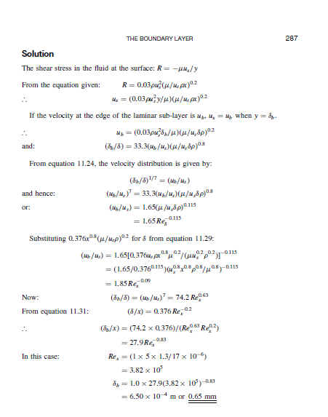

Slide 42
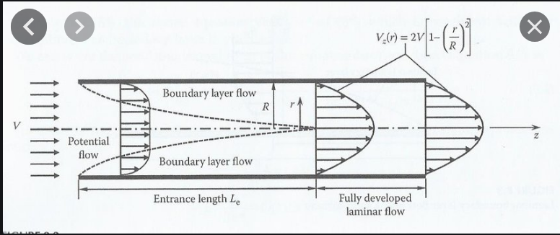
Flow Inside Pipe
R/ρ u² = 0.0384 Re ^{-1/4} u_{b}/u = 2.49 Re^{-1/8}
^{δ}_{b}/d = 62. Re^{-7/8}

Slide 44
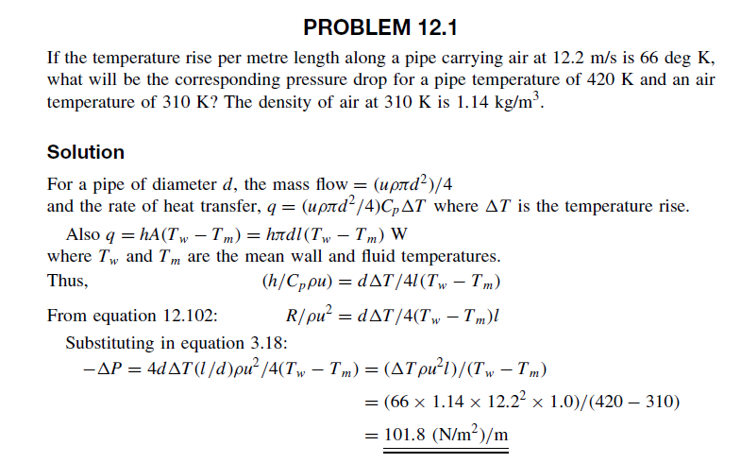

Slide 45
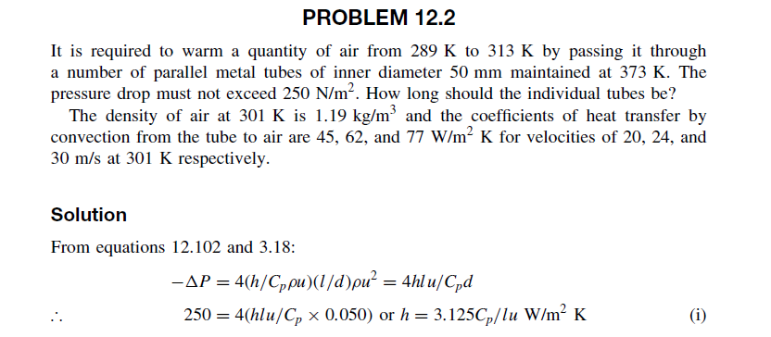
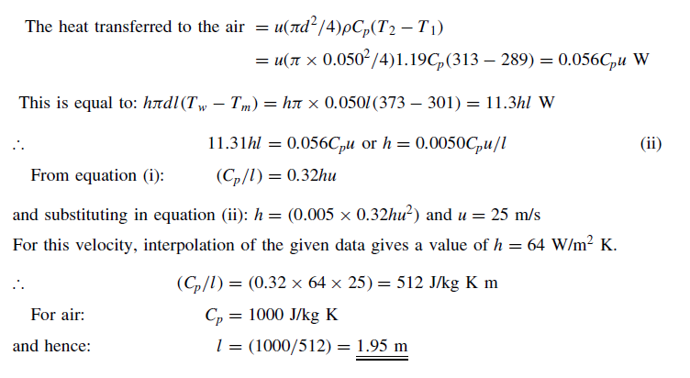

Slide 46
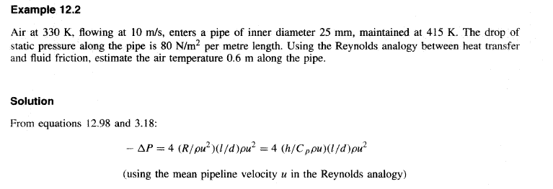
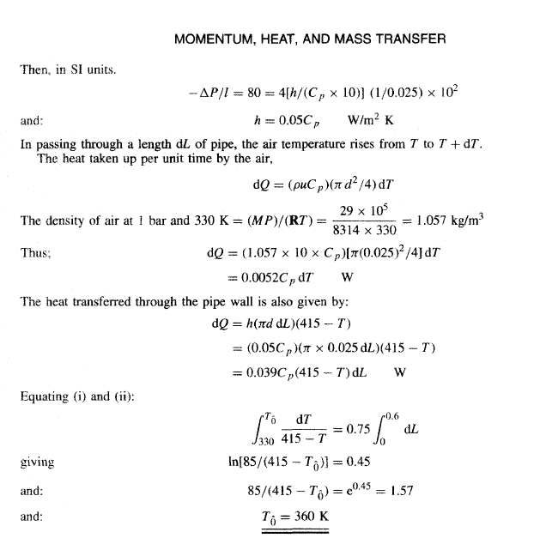

Slide 47
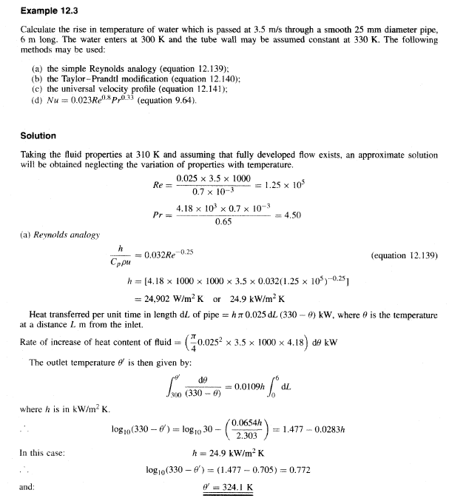

Slide 48
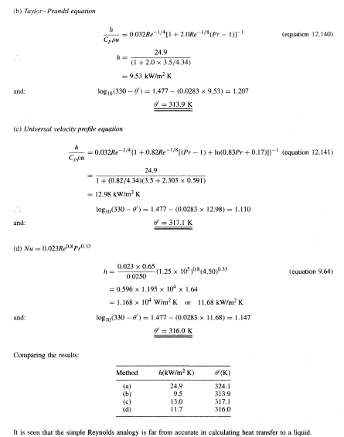

Slide 49
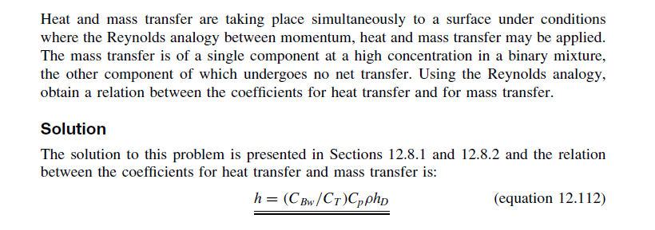

Slide 50
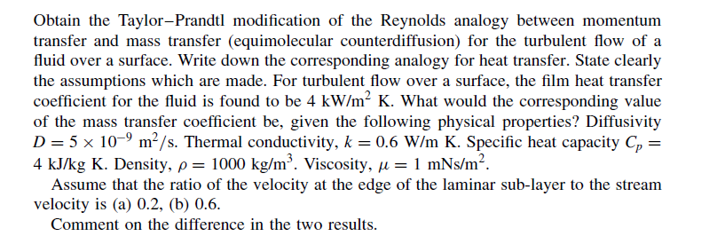
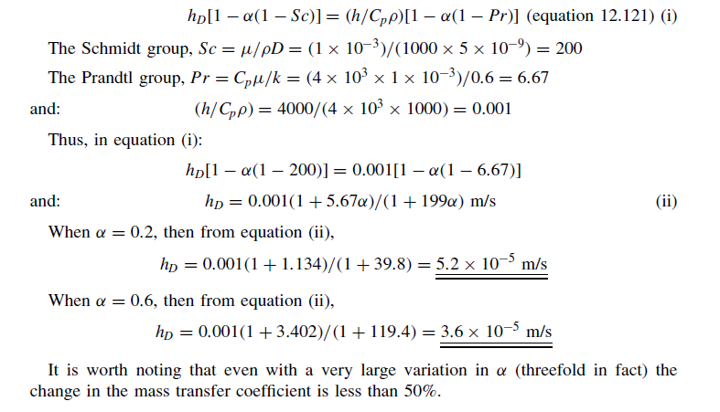

Slide 51
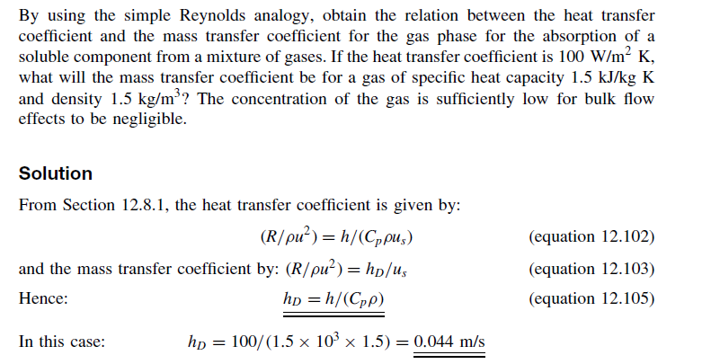

Slide 52


Slide 53

Then we need only find the temperature gradiant at the wall to evaluate ℎ. Therefore, the temperature distribution is:

Slide 54


Slide 55


Slide 56


Slide 57


Slide 58


Slide 59


